Slide 1


Slide 2
BH60M & BH100 with Electronic Transmission
Securing the CAN J1939 2.0B Communication Protocol, to make RIDES SAFER!

Slide 3
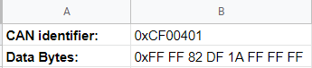
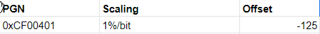
Decoding
Used Data
Parameters : According to J1939/71 Documentation
PGN 0xCF00401 is Electric Engine Controller

Slide 4

Decoding
Position 1,2,6,7 and 8 has FF i.e, 255. No raw parameter value (single byte) could have the value 0xFF. Therefore we don’t use them for decoding.
Position 3 is for actual engine percent torque. The raw value 0×82 is 130 decimal.
As we know scaling is 1%/bit and offset if -125, therefore the actual torque is 5%.
Data bytes 4 and 5 form the parameter Engine speed. 0x1ADF = 6879 decimal. Scaling is 0.125%/bit and offset is 0. Therefore the actual data is 859.875 rpm
Torque = 5%
RPM = 859.875

